Slide 1
B.Tech. Project PRESENTATION
PROBLEM STATEMENT: Applications of MR Fluid Actuators with Machine Learning
ANIMESH KUMAR SINGH (B20ME012) GARVIT MEENA (B20ME033)

Slide 2
Problem Statement: Applications of MR Fluid Actuators with Machine Learning
Background:
The project aims to integrate Magnetorheological (MR) Fluid Actuators into vehicle systems, utilizing Machine Learning (ML) techniques to optimize their performance.
Project Goals:
Changing vehicle damping properties through the integration of MR fluid-based actuators into the mechanical system.
Extract and analyze relevant data from MR fluid actuators to understand their behavior in diverse situations.
Utilize Machine Learning algorithms to process collected data.
Optimizing MR fluid actuators, enhancing overall performance and adaptability to the vehicle's changing environment.
Challenges:
1. Nonlinearity and Complex Behavior: Addressing nonlinear behavior in modeling and control.
2. Data Extraction and Preprocessing: Challenges in extracting meaningful data from MR fluid actuators.
3. Optimization Algorithms: Choosing suitable ML algorithms to enhance MR fluid actuator performance for vehicle dynamics.
4. Develop Simulink Model using references: Making Simulink model of MR damper using mechanical equations and also references from old research papers mentioned in references.

Slide 3
MOTIVATION
The main reason we chose Support Vector Regression (SVR) and machine learning as the foundations of our project is that we want to improve the performance of MR fluid devices. The reason behind this strategic choice is the desire for higher precision, greater adaptability, and better responsive mechanical parts.
Advantages for Mechanical Parts:
1. Improvement of Precision: Using SVR and machine learning will make MR fluid devices much more precise, which will lead to better performance .
2. More flexibility: MR fluid devices can easily adapt to different situations and needs in mechanical systems because they use advanced algorithms that make them more flexible.
3. Optimization: Employing SVR and machine learning to enhance methods for MR fluid devices can refine the system for mechanical parts, making it more responsive.
Benefits of Implementation:
Picture your vehicle as a finely-tuned race car. Implementing SVR and machine learning in MR fluid shock absorbers ensures precise damping adjustments, offering a smoother, more controlled ride on varying terrains.

Slide 4
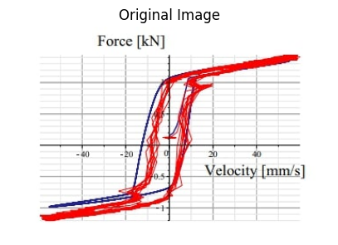
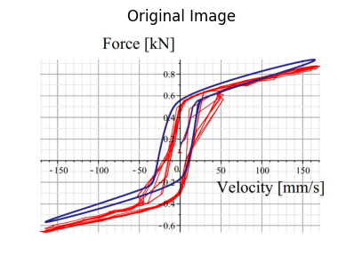
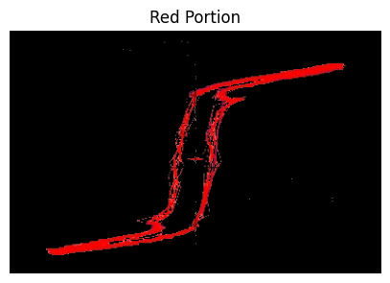
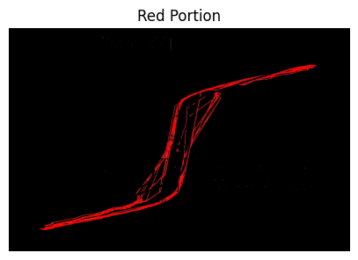
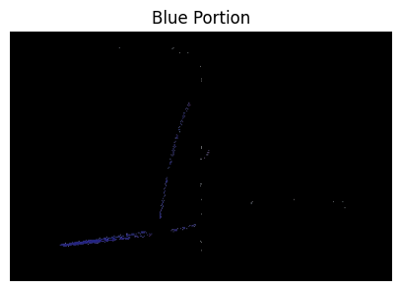
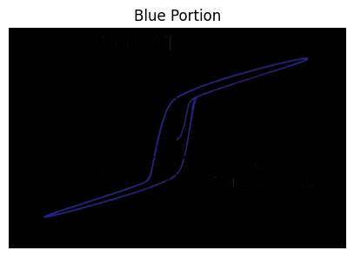
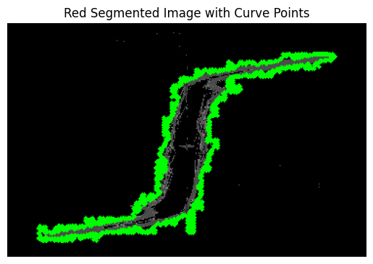
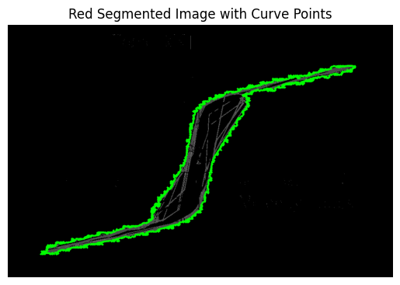
Data Extraction and Methodology
Data Extraction: Data extraction was performed to gather critical information from three different graphs of hysteresis loops.
Frequency: 0.5 Hz, Current: 1 A
Frequency: 1.5 Hz, Current: 0.3 A
Frequency: 3.5 Hz, Current: 0.6 A
Methodology:
The red and blue segments of the images were separated using color thresholds by using openCV library.
Contour detection was used to locate the primary curve of interest, selecting the largest contour for our analysis, also by openCV library.
Interpolation was then used to estimate additional points along the curve, ensuring an adequate number of data points for subsequent analysis.
Due to sparse data points near the middle of the curve, manual data inclusion was performed using the online software WebPlotDigitizer.
A transformation was applied to convert image coordinates to the desired real-world coordinate system.
0.5Hz / 1A
1.5Hz / 0.3A

Slide 5
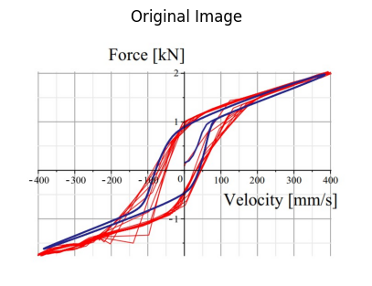
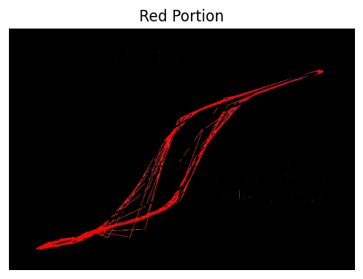
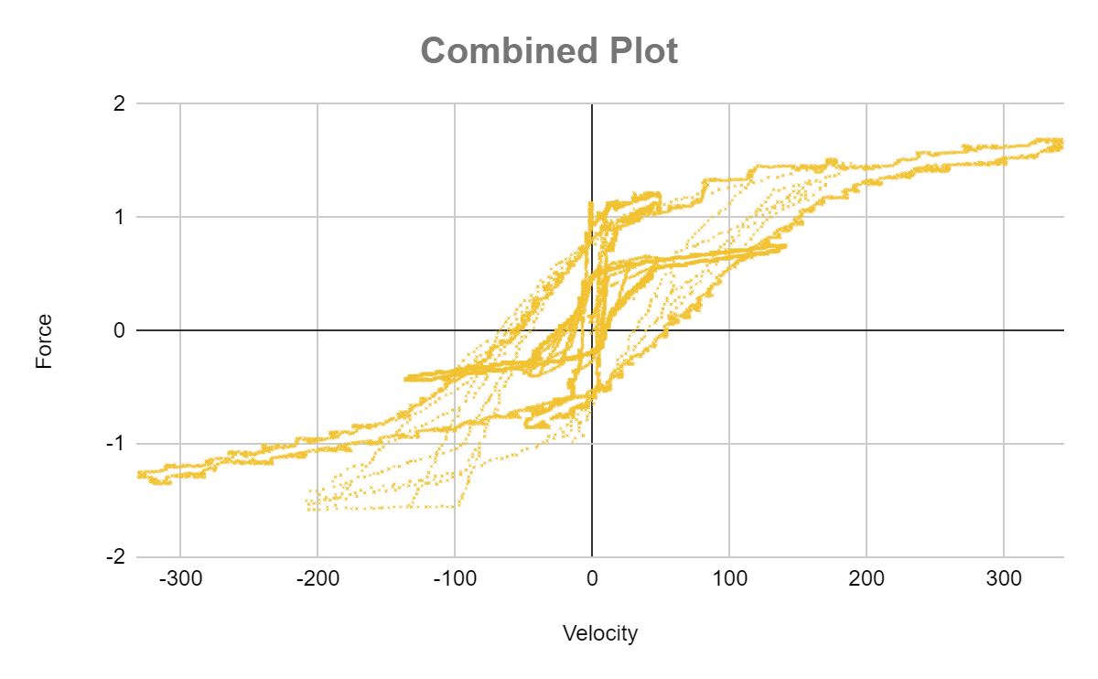
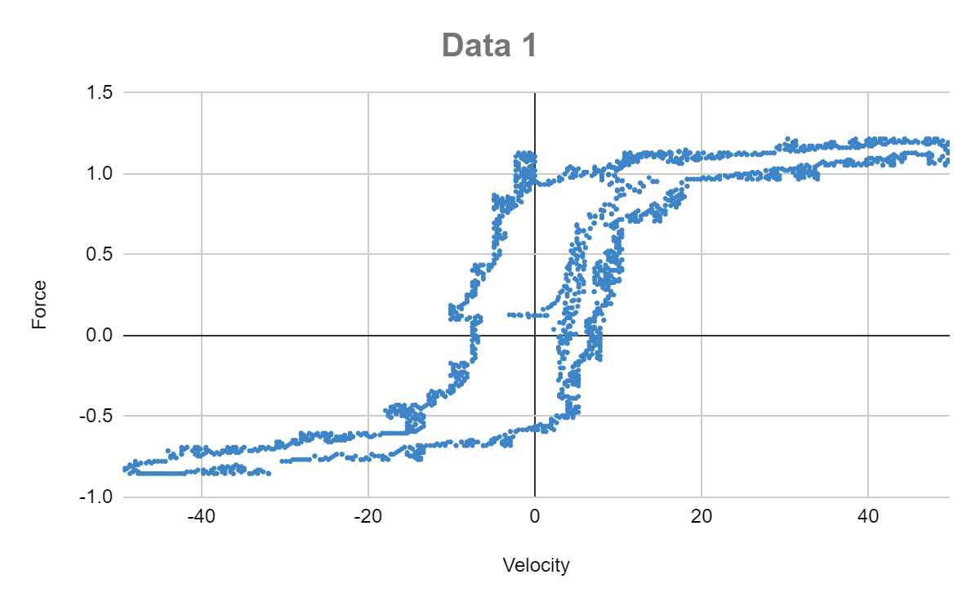
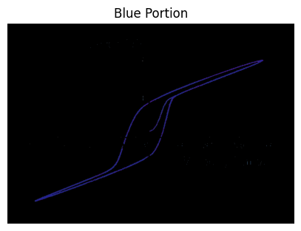
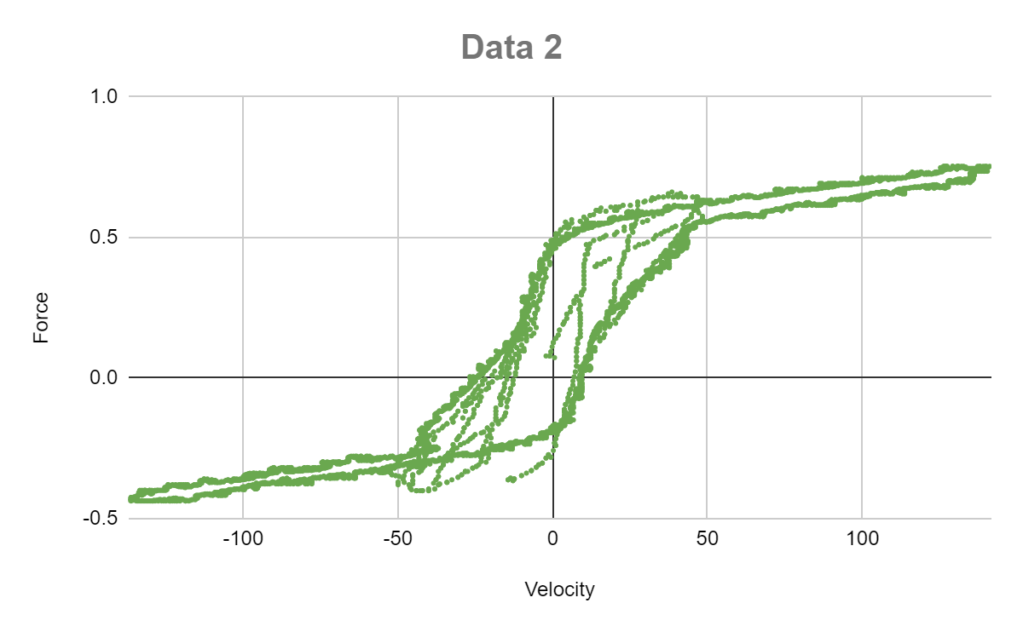
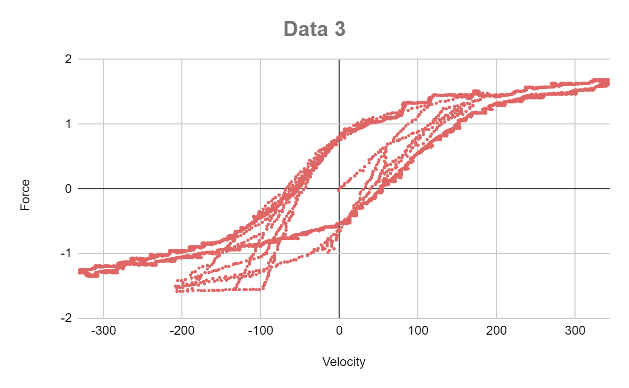
Results Obtained by data extraction
So, we got around 10k points each for the three graphs by OpenCV method in which around 2k for 0.5Hz/1A, around 3k for 1.5Hz/0.3A and around 5k data points for 3.5Hz/0.6A.
Further, by manual calculation we keep 1k data points in the middle of the contour of respectives graphs. So, around 13k data points is generated using this methodology.
3.5 Hz / 0.6 A

Slide 6


Machine Learning Implementation
(i). Feature Selection:
Identification of Influential Parameters
Relevance to Actuator Behavior
Fluid Dynamics Knowledge Integration
Validation through Machine Learning Models:
(ii). Data Splitting:
(iii). Data Standardization:
To enhance the convergence and performance of machine learning models, feature scaling is applied. The features are standardized using techniques such as StandardScaler, ensuring uniform scaling and preventing certain features from dominating the learning process.
(iv). Support Vector Regression (SVR) Model:
The project emphasizes the application of Support Vector Regression (SVR) due to its efficacy in handling continuous data and capturing intricate patterns in complex datasets. A hyperparameter tuning process is implemented using GridSearchCV to optimize SVR parameters, including the choice of kernel, regularization parameter (C), and epsilon.

Slide 7
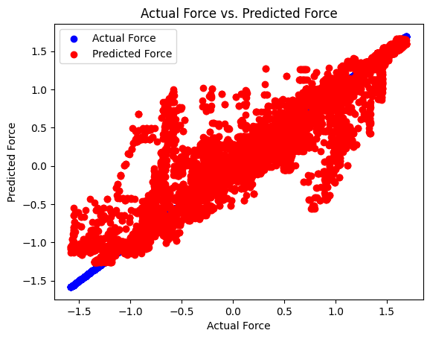
Modeling Approach and Results:
Model Selection:
We employed Support Vector Regression (SVR), Random Forest, and Neural Networks as our main models for predicting magnetorheological damper force based on input parameters such as velocity, frequency, and current.
Accuracy Comparison:
SVR, our main model, closely followed with an R² Score of 0.84, showcasing robust predictive capabilities.
Random Forest exhibited the highest predictive R² Score, achieving an impressive 0.87. But, we have used SVR as our main model.
Neural Networks delivered competitive results with an R² Score of 0.82 or 0.83.
Prediction of Force: When it comes to modeling mechanical systems such as dampers and suspensions, the choice between Support Vector Regression (SVR) and Random Forest (RF) may depend on the specific characteristics of the problem and the goals of the analysis. Here are some considerations in the context of dampers and suspensions:
1. Nonlinear Behavior
2. Physical Interpretability
3. Computational Efficiency
4. Hyperparameter Tuning

Slide 8
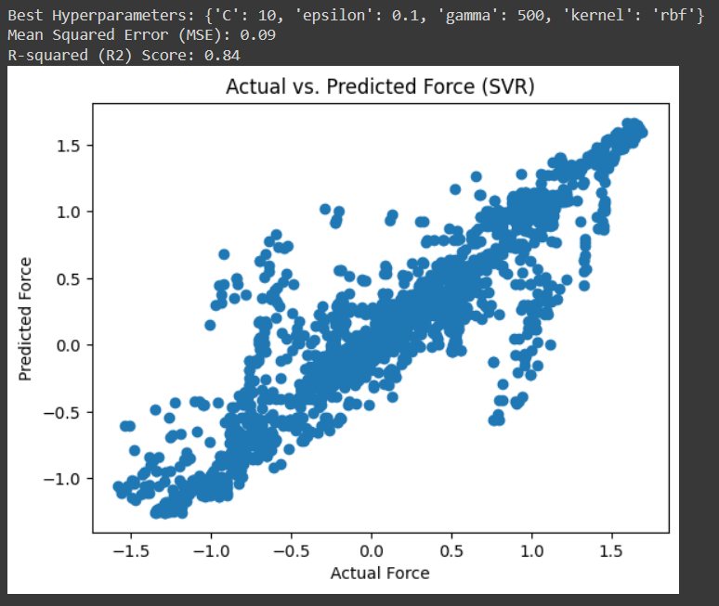
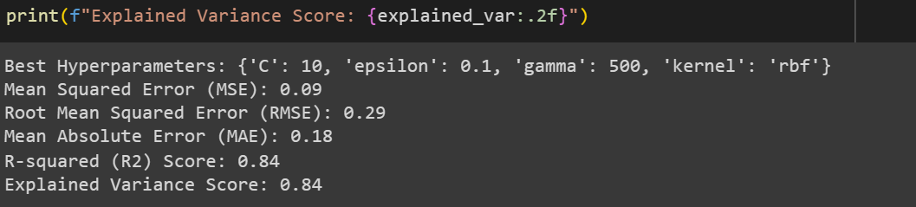
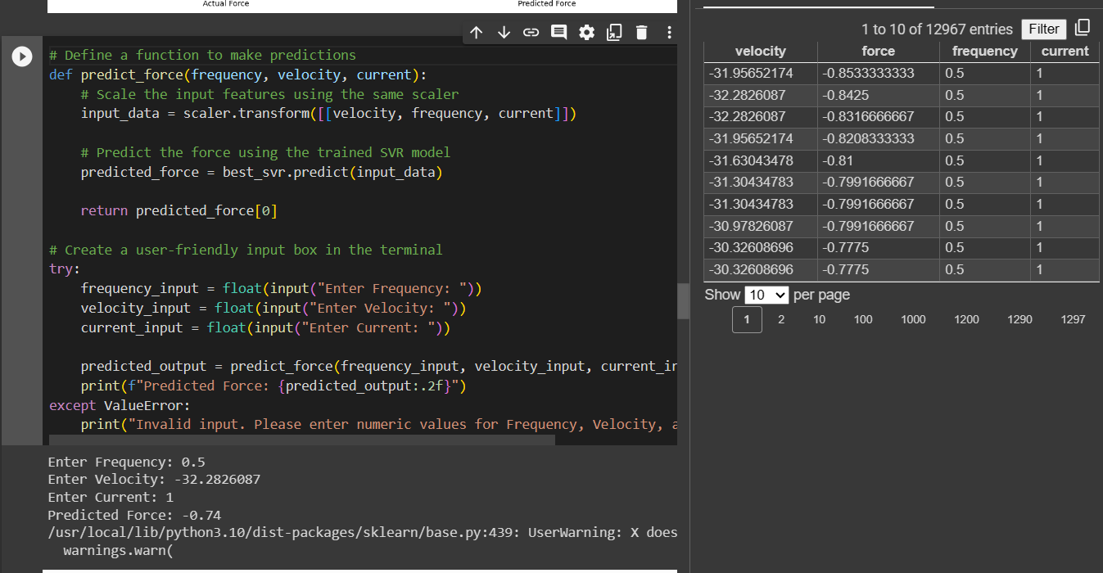
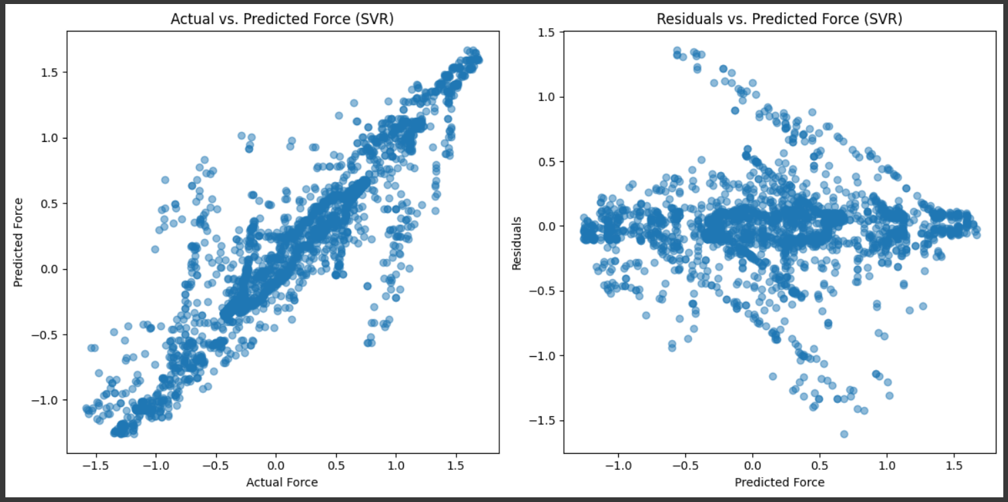
Best Hyperparameters we got using GridSearch in SVR
RESULTS (SVR)
Predicted value from our model
Actual Values of data

Slide 9
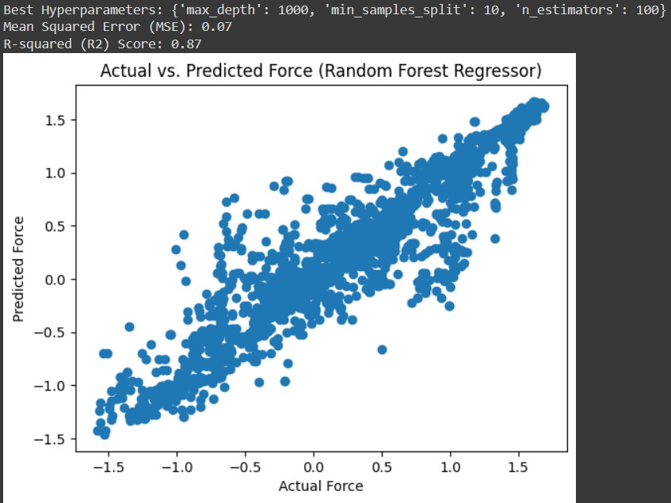
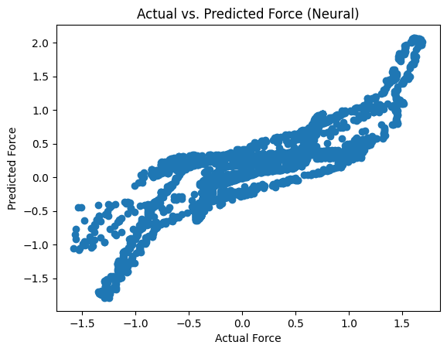
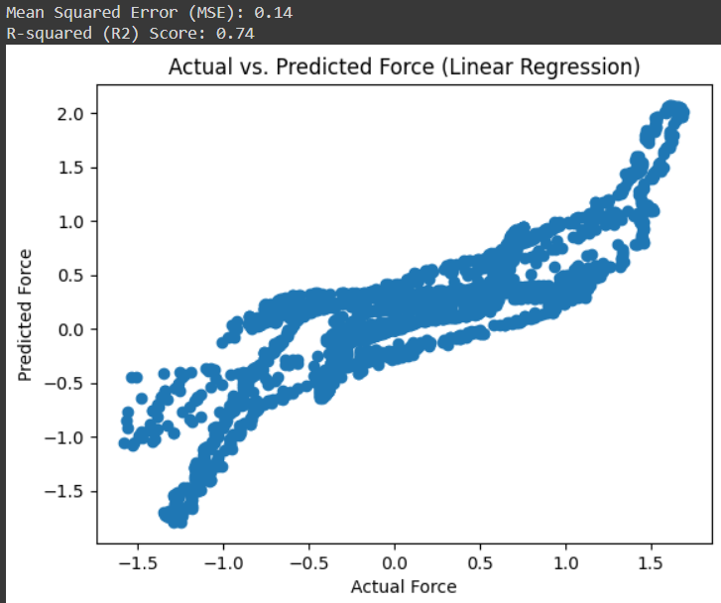
Other Models Results
Random Forest: 1) Details: Ensemble learning model. 2) Hyperparameters: Tuned tree count, depth, leaf size, etc. 3) Rationale: Suitable for capturing non-linear patterns in data, serving as a benchmark against SVR
Neural Networks: 1) Details: Deep learning model with multiple layers. 2) Hyperparameters: Tuned layers, neurons, activation functions, learning rate, etc. 3) Rationale: Explored for its ability to model complex relationships in fluid behavior, providing an alternative to SVR.
Linear Regression: 1) Details: Simple linear model. 2) Hyperparameters: No tuning as it's a parametric model. 3) Rationale: Used as a baseline for simplicity and interpretability in result comparison.
.Having explored various models, our focus narrowed down to support Support Vector Regression (SVR) due to its favorable performance. We utilized GridSearchCV for hyperparameter tuning, optimizing the SVR model for accurate predictions. Subsequently, we employed the trained SVR model to predict force values based on given parameters such as frequency, velocity, and current. The comparison of these predictions with values obtained from a Simulink model is crucial, as it serves as a validation step for aligning our machine learning predictions with a simulated physical model. This comparison aids in understanding the SVR model's proximity to the expected behavior of the magnetorheological fluid damper under different operational conditions, contributing valuable insights for potential applications in vehicle suspension systems.

Slide 10

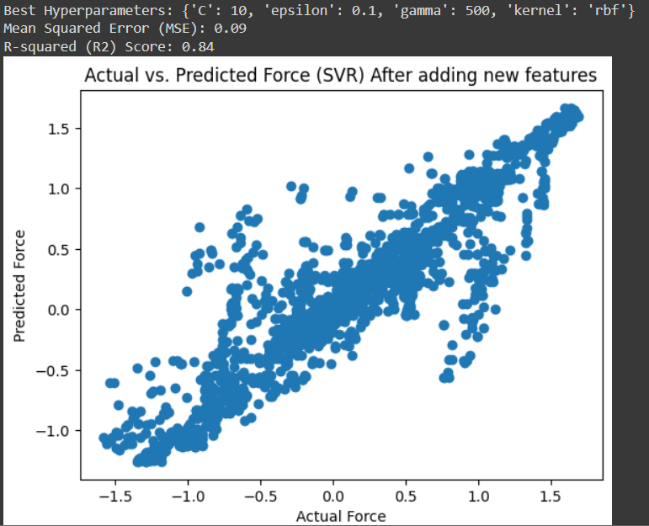
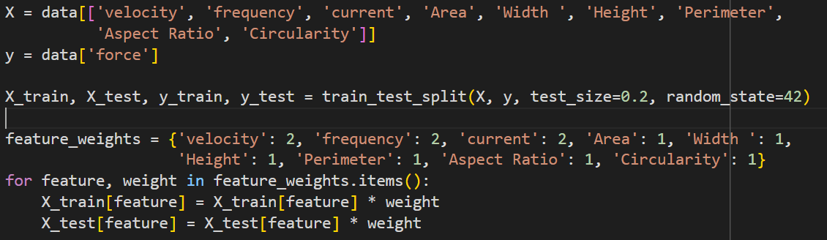
→ Added new features:
We initially extracted the underlined features and applied Support Vector Regression (SVR). However, the expected increase in accuracy did not materialize. In an attempt to improve results, we explored an alternative approach by assigning different weights to the features. Despite these efforts, the outcomes remained consistent, and we did not achieve the anticipated increase in accuracy. Ultimately, the implementation was undertaken with the primary objective of improving accuracy, but unfortunately, the desired results were not attained.
Results:

Slide 11
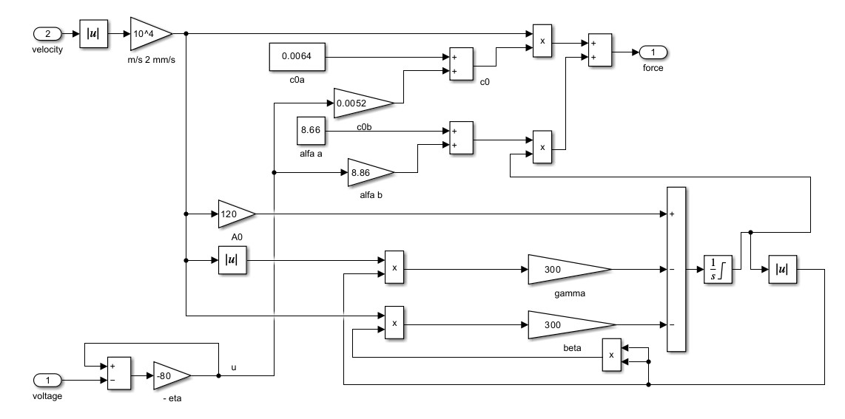
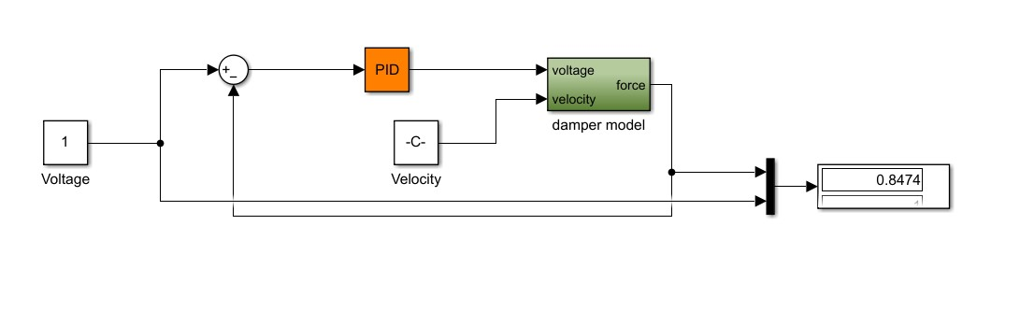
Simulink Model
So, it is giving output as 0.8474kN which is nearby to the actual force value i.e. 0.853kN at velocity = 31.95652174mm/s, and further we predicted the force value using our SVR model, which is around 0.76kN.

Slide 12
Conclusion and Applications
Conclusion:
1. Precision Analysis: Through the use of sophisticated contour analysis, detailed data was obtained, creating a solid dataset that is essential for understanding the behavior of MR fluid actuators.
2. SVR Precision: SVR modeling predicted MR damper forces with dynamic adaptability, accurately capturing complex relationships.
3. Simulink Integration: A virtual testing ground for MR fluid actuator optimization was made possible by the seamless integration of Simulink, which connected theory and application.
Real-World Impact:
Intelligent Control Systems Force prediction in the absence of real data helps create intelligent control systems that maximize handling, comfort, and stability.
Revolutionizing Dynamics: By converting theoretical developments into noticeable advancements in suspension applications, our project seeks to revolutionize real-world vehicle dynamics.

Slide 13
THANK YOU !!
LINK TO OUR REPORT: Link

Slide 14

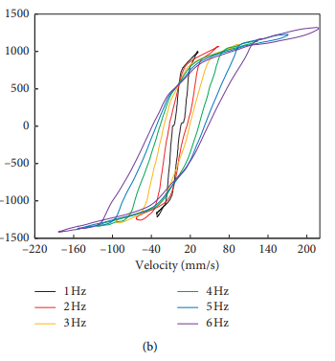
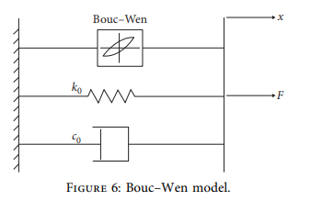
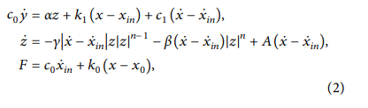

SIMULINK EXPLANATION

Slide 15
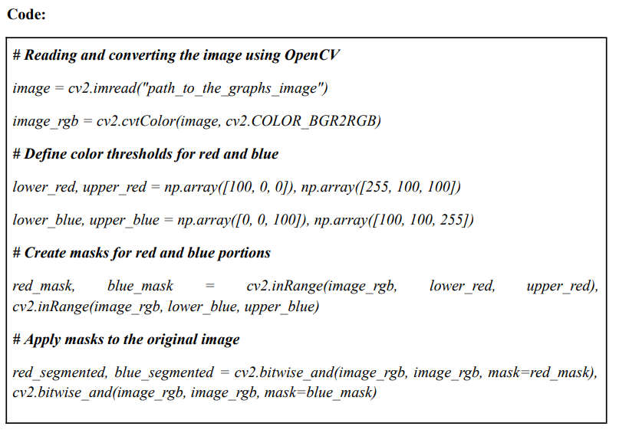

Slide 16
